Slide 1
NAVIGATING THE LINUX LANDSCAPE: A FEASIBILITY STUDY ON EMPLOYING LLAMA V2 FOR CRAFTING A CONTEXT-AWARE VIRTUAL ASSISTANT TAILORED FOR ARCH LINUX USERS
Eng. Andrés M. Prieto Álvarez

Slide 2

What’s linux?

Slide 3
A story of sharing

Slide 4

GNU
**Short term for GNU's Not Unix

Slide 5
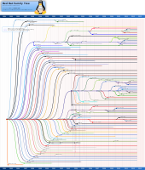
Taken from: https://en.wikipedia.org/wiki/List_of_Linux_distributions

Slide 6
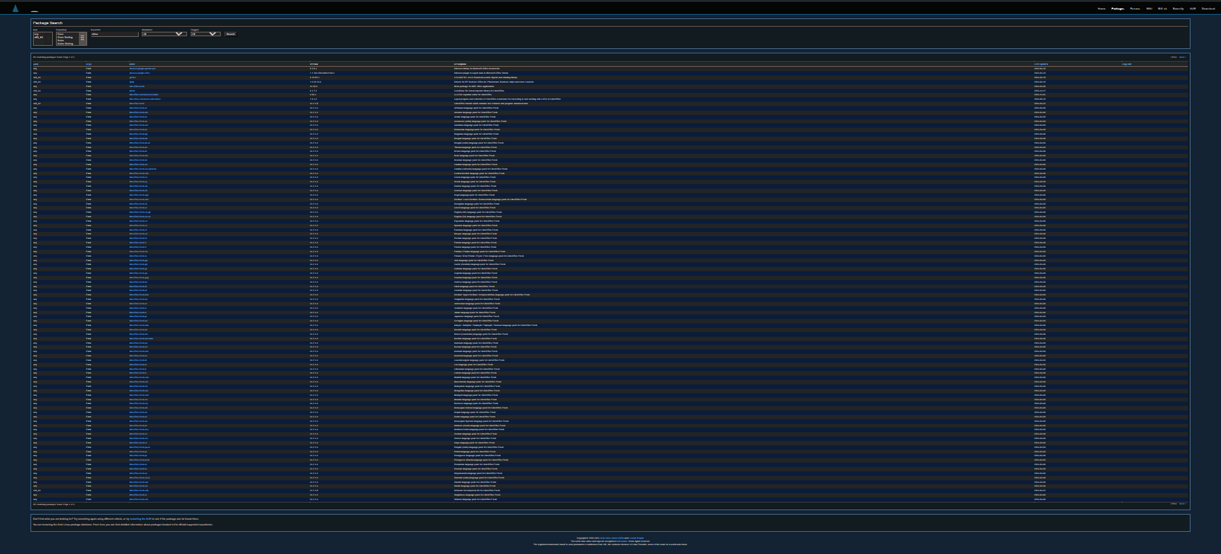
Taken from: https://archlinux.org/packages/?q=office

Slide 7
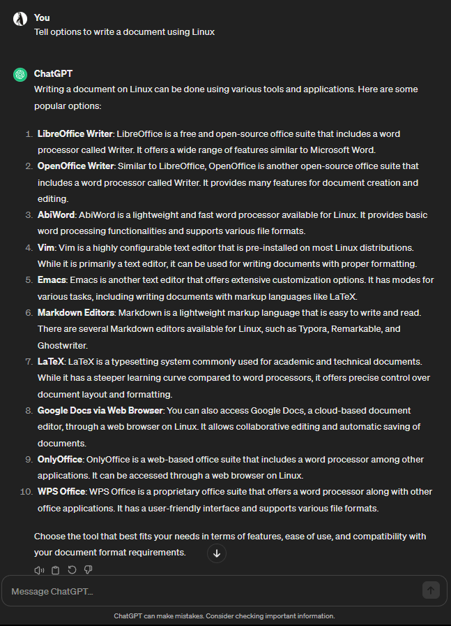
**There are missing options

Slide 8
A quick state of the art about virtual assistants

Slide 9
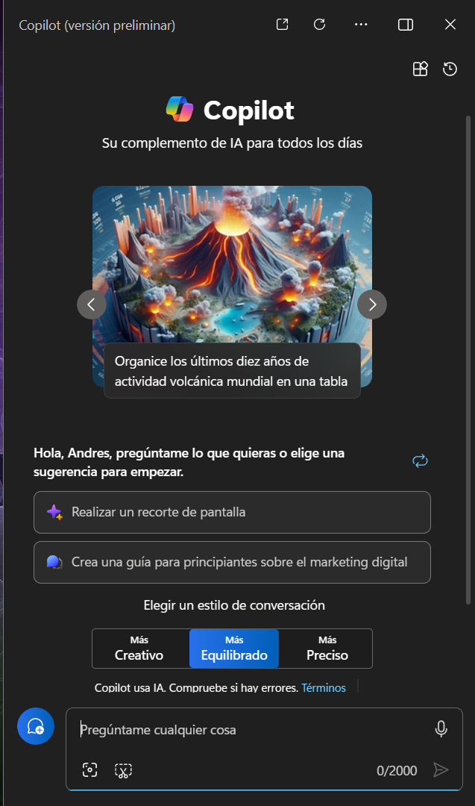

Slide 10
So, what about Linux distributions?

